Slide 1
The NESDIS Cooperative Research Program
Ingrid Guch
Ingrid.Guch@noaa.gov
Director, NESDIS/STAR Cooperative Research Program

Slide 2
Cooperative Resarch Program
The Cooperative Research Program (CoRP) of NESDIS' Center for Satellite Applications and Research (STAR) manages a coast-to-coast research coalition of the federal government and universities.
CoRP's branches, Institutes and its Center work together on remote sensing of the environment in key focus areas:
Algorithms, products and applications for satellite data
Observation simulations
Calibration, intercalibration and validation of satellite data
Observing system design

Slide 3
What we do
Encourage, and are a part of, federal/academic partnerships
We have a mix of projects – some are higher risk and some are lower risk, all stages can benefit from federal/academic partnerships
Common opinion is that all of our projects should be “cutting edge” since we are with academia. However, it is important that some projects are R2O (lower risk) so that the pathway is “well lit” as the cutting edge projects mature
Answer questions about federal/academic partnerships
Help CI/CREST employees understand NOAA and vice versa

Slide 4
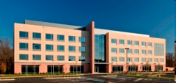
NESDIS Cooperative Institute and science center Research Themes
CICS (Cooperative Institute for Climate and Satellites)
University of Maryland
North Carolina State University
Climate and Satellite Research and Applications
Climate and Satellite Observations and Monitoring
Climate Research and Modeling
CREST (Cooperative Remote Sensing Science & Technology Center)
City College New York
(Host NOAA Line Office is Office of Education)
Climate
Atmosphere and Weather
Land Processes and Water Resources
Coastal and Ocean Waters
CoRP – 5 FTEs
CoRP – 0 FTEs
CIMSS (Cooperative Institute for Meteorological
Satellite Studies)
University of Wisconsin-Madison
Environmental Models and Data Assimilation
Satellite Meteorology Research and Applications
Satellite Sensors and Techniques
Education, training & outreach
CIRA (Cooperative Institute for Research
in the Atmosphere)
Colorado State University
(Host NOAA Line Office is OAR)
Satellite algorithm development, training and education
Regional to Global Scale Modeling Systems
Data Assimilation
Climate-Weather Processes
Data Distribution
CoRP – 6 FTEs
CoRP – 4 FTEs

Slide 5
Center for Remote Sensing Science and Technology (NOAA-CREST)
Develops skilled leaders and technical experts focusing on remote sensing and technology research
Engages and excites general public and the next generation of students in NOAA-related sciences
Works to increase underrepresented minorities in NESDIS workforce
STAR and numerous STAR partners have hired CREST students (CIs, NESDIS OSD, NWS, NCDC and Private Sector)

Slide 6
Suomi-NPP VIIRS day-night visible/reflective imagery
Suomi-NPP VIIRS Imagery:
16 Medium-resolution bands
5 Imagery-resolution bands
Day-Night-Band (DNB)
Near-Constant Contrast (NCC) Imagery product:
Derived from the DNB
Reached the Validation 1 level in January 2014
Fully “operational” and available to all users
Highly valuable in northern latitudes
Visible/reflective imagery available during long dark periods in winter
Frequent views/passes in polar regions
Only caveat is the long (~6 h) latency for non-direct-broadcast product
(Courtesy of D. Hillger, C. Seaman)
Animation of VIIRS NCC images of icebergs, 20-26 December 2013

Slide 7
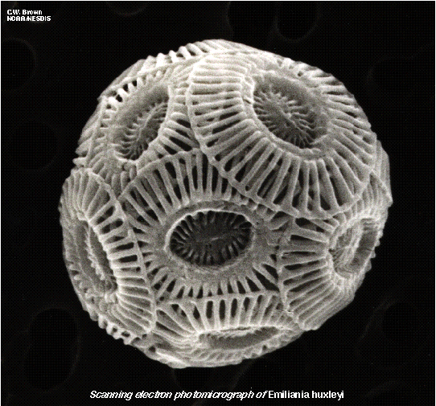
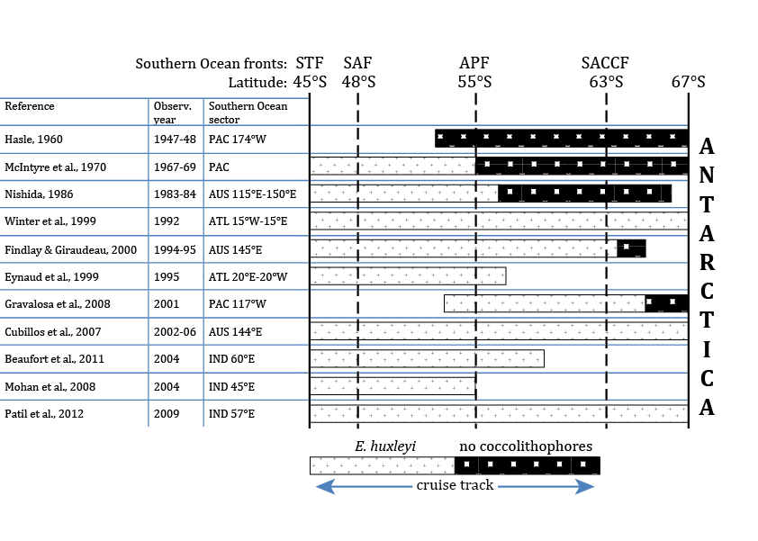
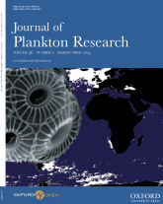
Poleward Expansion of the Coccolithophore Emiliania huxleyi
E. huxleyi is one of the major calcifiers in the pelagic ocean
Reviewed different lines of evidence
E. huxleyi appears to be expanding poleward
Additional observations and modeling required
a)
b)
Caption: (a) Presence and absence of Emiliania huxleyi from 11 oceanographic surveys in the Southern Ocean from 1947 to 2009; (b) Percentage of surface area of classified E. huxleyi blooms in CZCS (1978–86) and SeaWiFS (1997–2007) in the region 30°-70°S /130°-170°E (blue) and in situ observations of E. huxleyi abundance in the same region (red).
Winter, A., J. Henderiks, L. Beaufort, R. E. M. Rickaby, and C. W. Brown (2014) Poleward expansion of the coccolithophore Emiliania huxleyi. Journal of Plankton Research 36(2): 316-325, doi: 10.1093/plankt/fbt110.

Slide 8
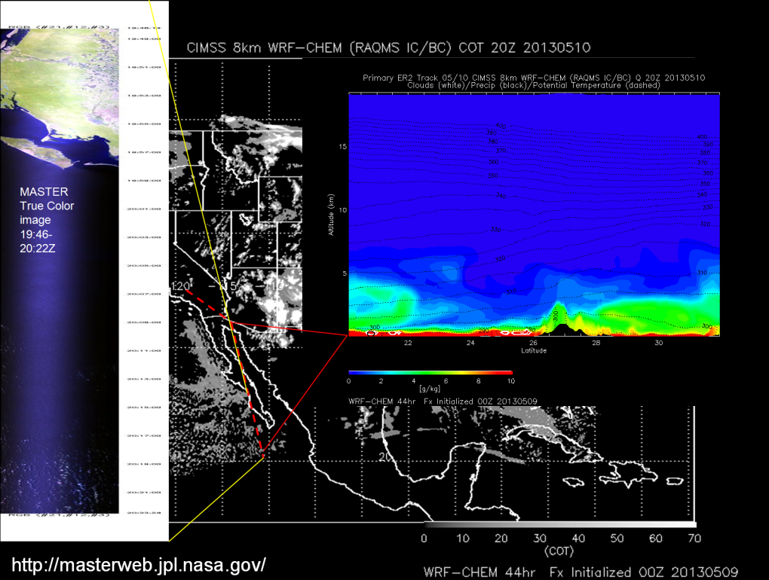
Near-Real-Time Proxy Support for GOES-R ABI
Provided cloud forecasting support for airborne SNPP/METOP-B cal/val field mission (May 10-31, 2013).
The primary objective of the SNPP/METOP-B cal/val mission was to collect cloud free radiance measurements from remote sensing instruments onboard the NASA ER2 during SNPP and METOP-B satellite overpasses in the vicinity of the Gulf of California.
8km WRF-CHEM 44hr cloud optical thickness (COT) predicts clear air off Baja Coast on May 10, 2013. Airborne MASTER imagery (NASA/JPL) verifies COT forecast .
Also provided aerosol forecasting support for NOAA airborne Southeast Nexus (SENEX) air quality/ climate field mission in SE US (June 5-July 7, 2013)
ER2 SNPP cal/val Flight plan May 10, 2013
Brad Pierce STAR/ASPB

